Slide 1
Unit 7 Solving Systems of Equations by Elimination
Algebra 1

Slide 2
Solving Systems of Linear Equations by Elimination
STEPS
Line up the variables.
Pick a variable to eliminate.
Multiple one or two of the equations by a number to get the coefficients to cancel.
Add the equations together.
Solve for the remaining variable.

Slide 3
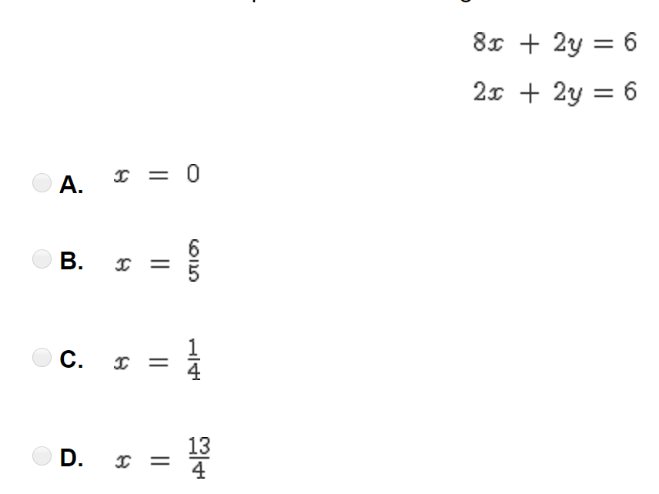

Slide 4
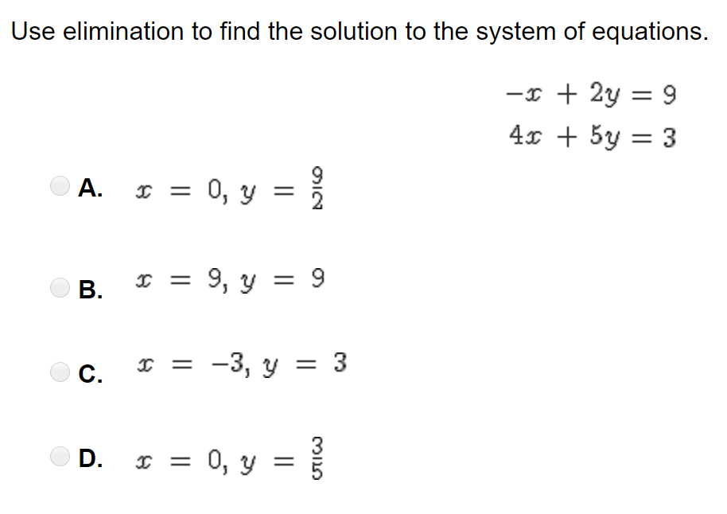

Slide 5
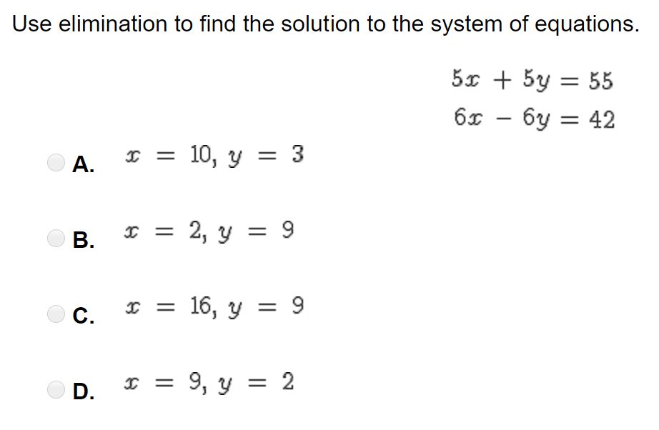

Slide 6
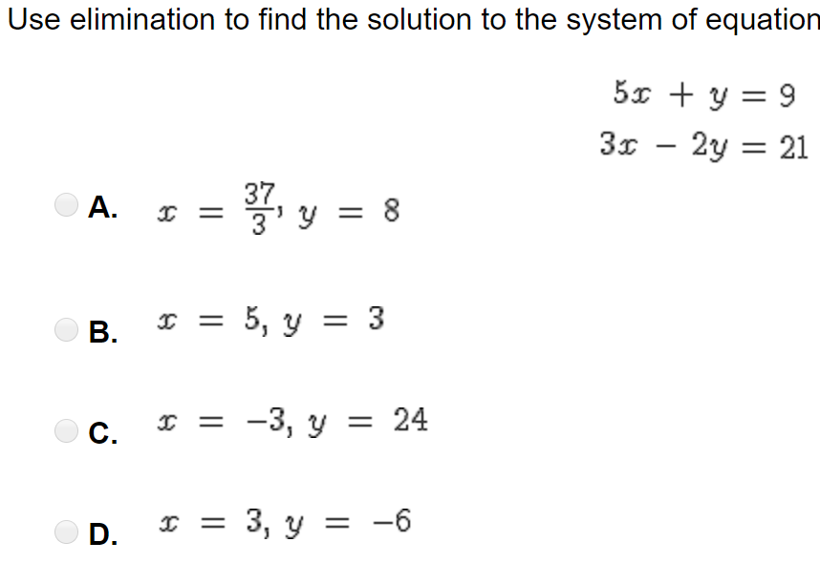

Slide 7
